Slide 1
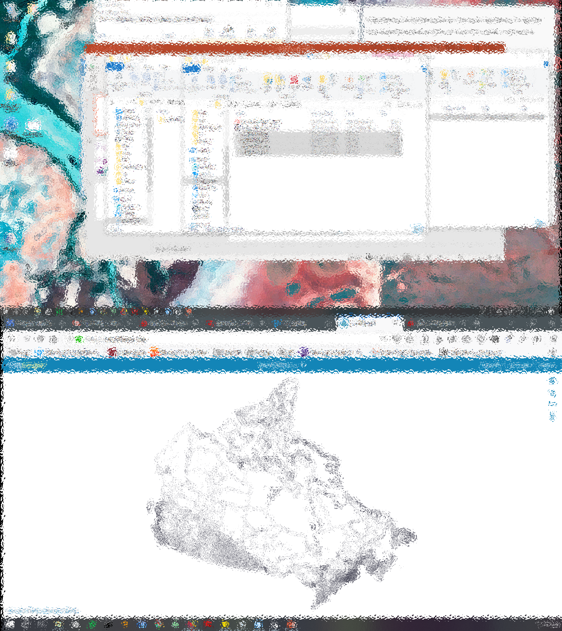
Leveraging Geospatial Data in R Choropleth Maps
LIT Learning Event– May 13, 2021 Centre for Special Business Projects, Statistics Canada
Julia Conzon
Geographic Information Scientist
julia.conzon@canada.ca

Slide 2
Outline
What is GIS
Geospatial R packages
Thematic Maps
Choropleth Maps
R programming:
tmap
sf + ggplot2

Slide 3
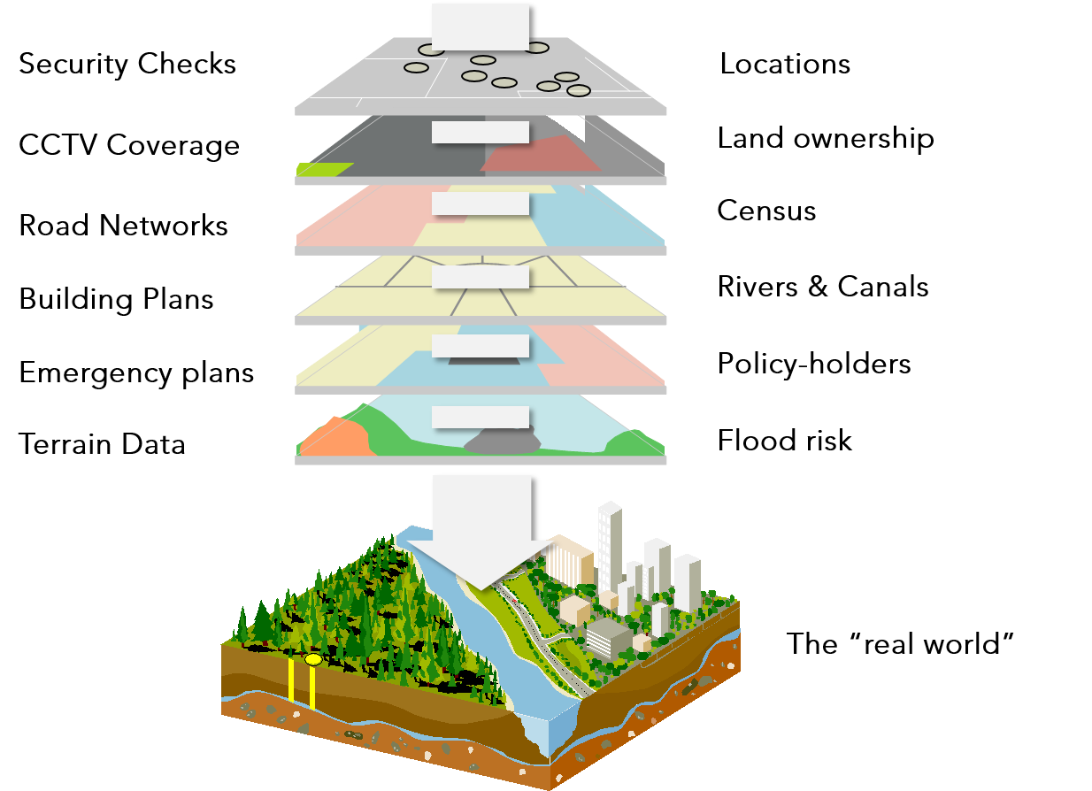
What is GISystems?
In general, Geographic Information Systems leverages geospatial data, statistical/analytical methods and technologies to interpret the “real world”
These technologies (e.g., software or programming libraries) are used to collect, store, retrieve, manipulate, explore, analyze and display geospatial data
Geospatial technologies, techniques, and data standards through organizations like Open Geospatial Consortium
Source
Notes:
In general, Geographic Information Systems leverages geospatial data, statistical/analytical methods and technologies to interpret the “real world”
These technologies (e.g., software or programming libraries) are used to collect, store, retrieve, manipulate, explore, analyze and display geospatial data
There are international (e.g., Open Geospatial Consortium) and national communities that support and establish standards for these technologies and techniques, and also geospatial data formats

Slide 4
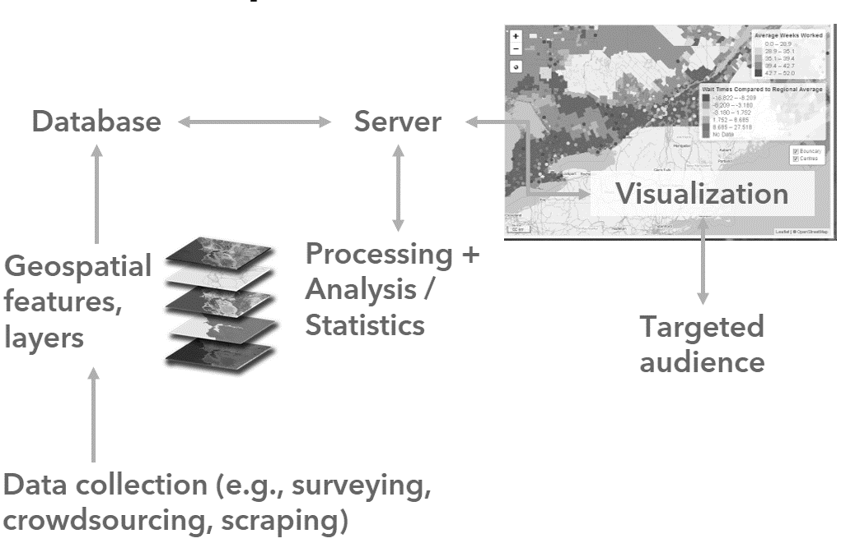
What is GIScience?
https://github.com/Noznoc/gis-101
Notes:
ttps://www.gislounge.com/using-r-gis-software/

Slide 5
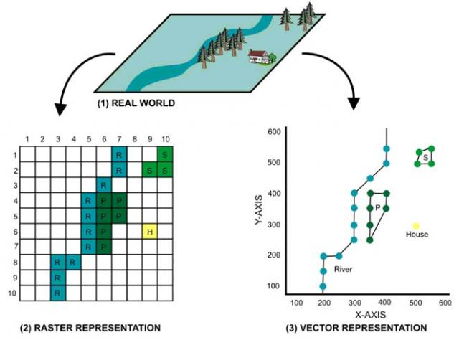
Geospatial Features
Geospatial features are digitized geospatial representations
These features can be discrete (e.g., buildings and roads) or continuous (e.g., pollution, elevation)
Two geospatial data models: vector and raster
Source
Notes:
- Discrete: individually distinguishable, phenomenon doesn’t exist between observations
- Continuous: gradual variation across range of values and values exist between observations, though not necessarily can be identified (but can be predicted/estimated)

Slide 6
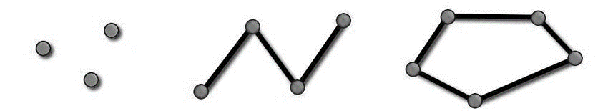
Vector Model Components
Geometry: the shape of the vector object
Point
Line
Polygon
(x_{n}, y_{n})
(x, y)
(x, y)
(x₁, y₁)
(x₁, y₁)
(x,y), (x,y)
(x₁, y₁,x₂,y₂,…x_{n-1},y_{n-1},x_{n},y_{n})
(x₁, y₁,x₂,y₂,x₃,y₃,…x_{n},y_{n},x₁,y₁)
Location: coordinate system (longitude, latitude)
Attributes: variables/fields associated with a feature
Style: color, form, outline, size, pattern, lightness
(x,y) → (4018517.282186, 2008752.042743)
Source
Notes:
Vector data models have four main components: geometry (AKA shape), location (coordinate system), symbology, and attributes
Discussion each component

Slide 7
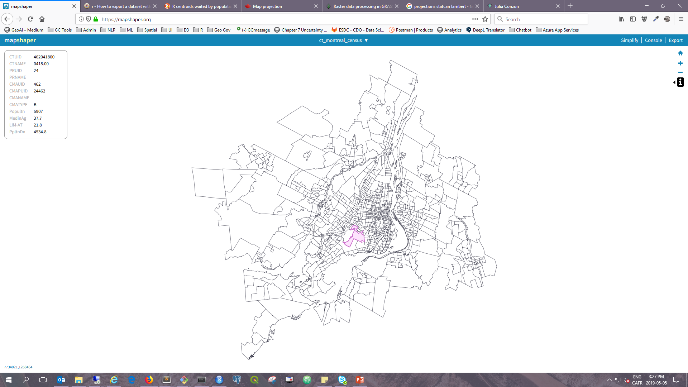
E.g., Montreal Census Tracts
Geometry and location linked to attributes
Notes:
Example of attribute data
Image to left highlights the table structure that attribute information tends to be stored as
Image to the right is a real-world example of the Census Subdivisions

Slide 8
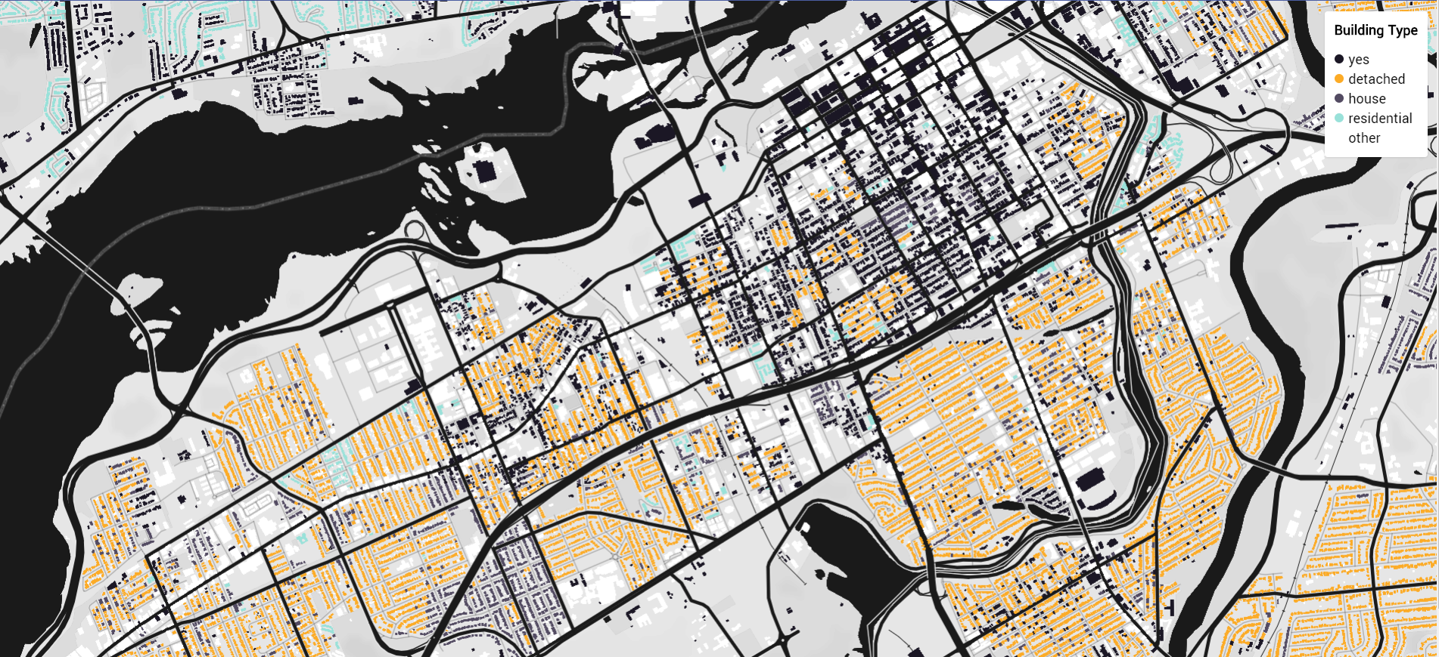
E.g., Ottawa/Gatineau Basemap
River
Road=highway
Road=secondary
Buildings
Style linked to geometry, location, and attribute!
Source
Notes:
In this case, vector data was used to create a basemap (like what is seen on Google Maps)
There is symbology to represent the different features as well as different attributes within the same feature

Slide 9
Vector Formats + Standards
Open Geospatial Consortium (OGC) Compliant
Well-Known Text (WKT)
GeoPackages
Shapefiles
https://www.opengeospatial.org/docs/is
Keyhole Markup Language (KML)
GeoJSON

Slide 10
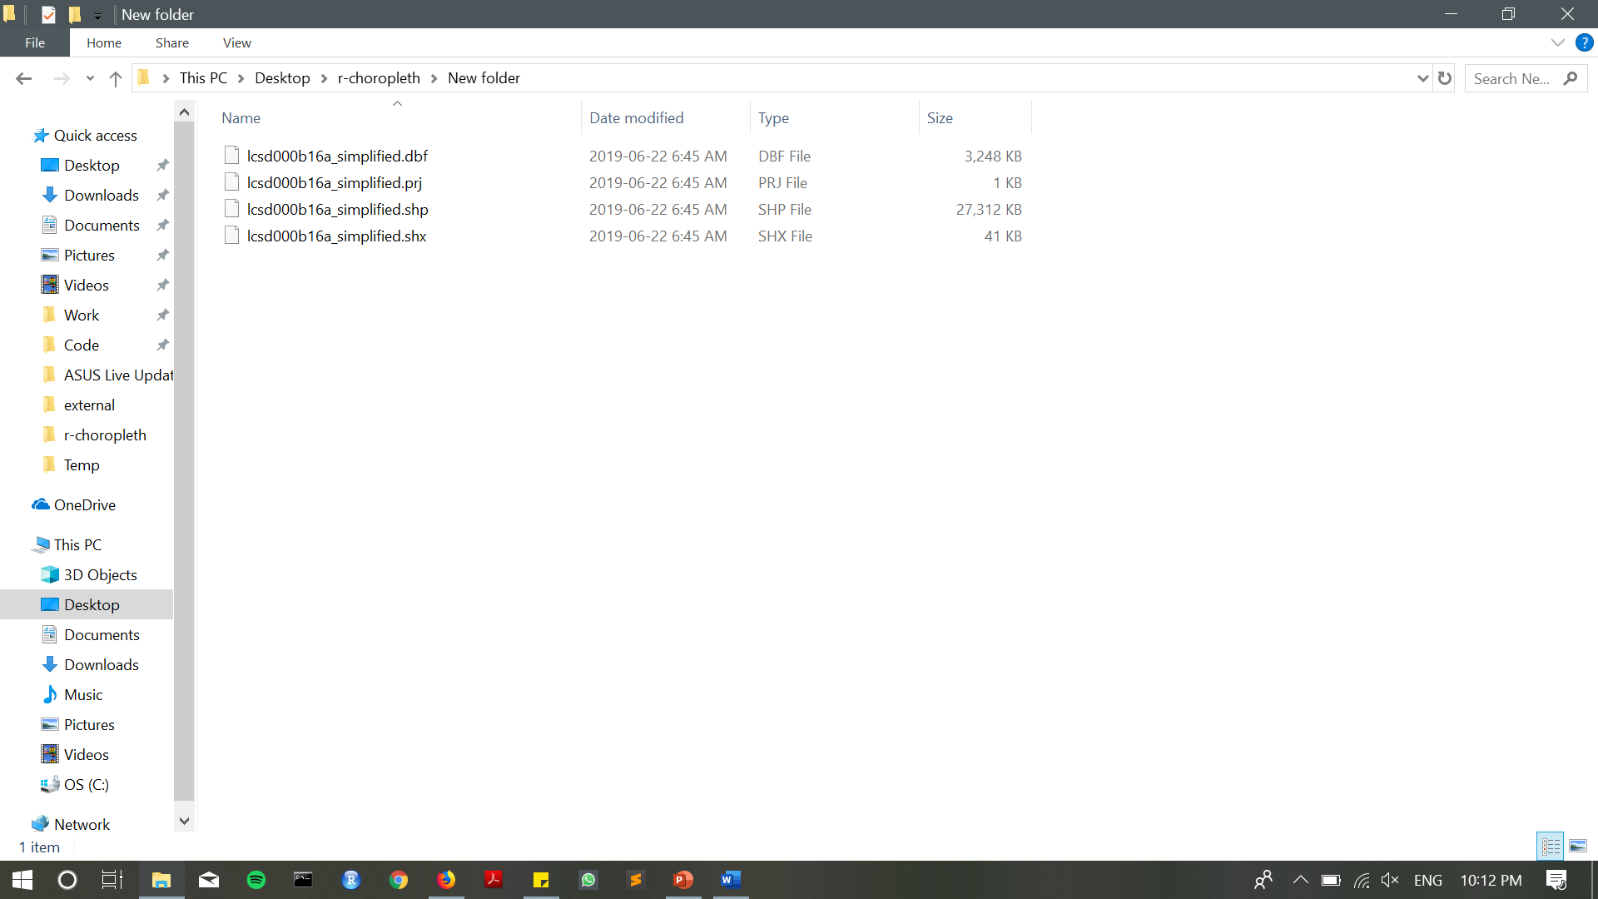
Shapefiles (Esri)
– attribute
– projection
– geometry
– shape index

Slide 11
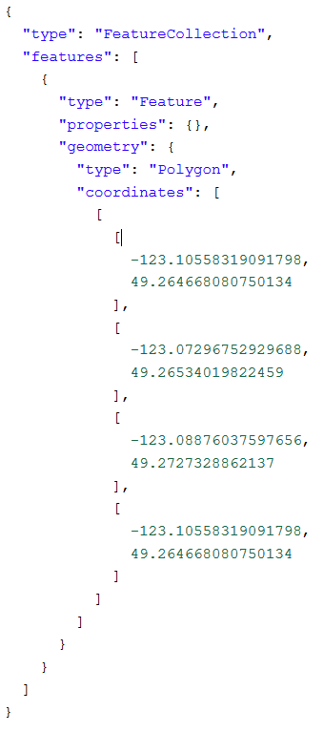
GeoJSON (open)
Represents simple geographic features (points, lines, strings, polygons) and non-spatial attributes
Popular for web maps

Slide 12
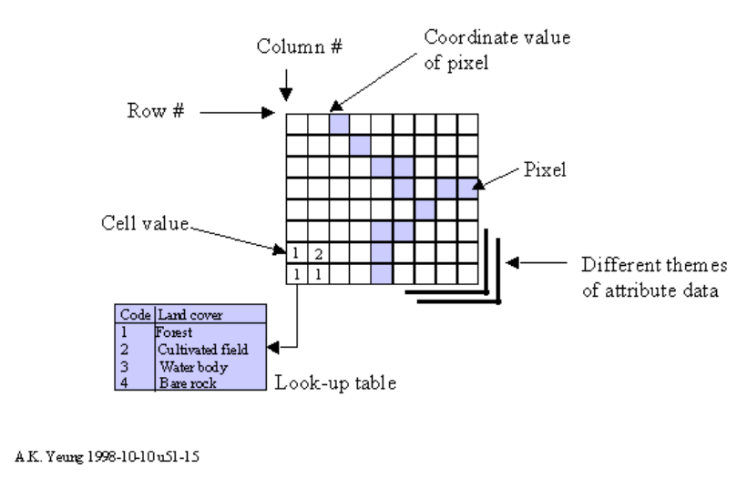
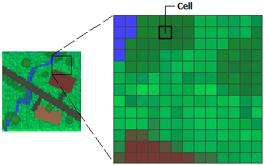
Raster Model Components
Rasters: digital aerial photography, satellite imagery, scanned maps, digital images (e.g., street-level images)
Matrix of equal sized cells/pixels represented as a grid of rows and columns
Each cell/pixel has an attribute value
Source
Source
Notes:
- Touch on all components

Slide 13
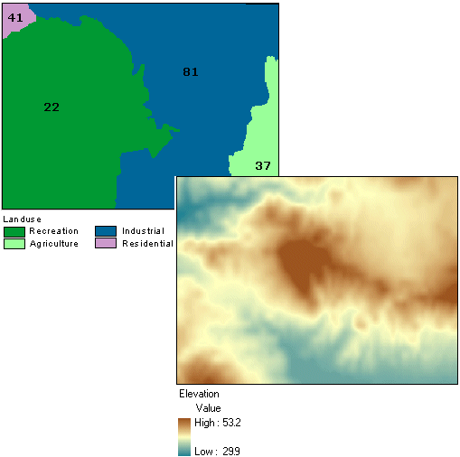
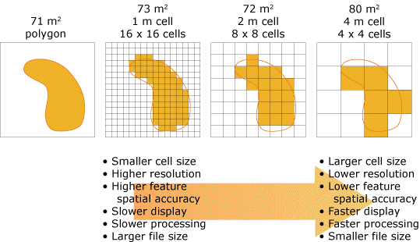
Raster Data
Discrete
Continuous
Source
Source
Notes:
Explain the difference between discrete and continuous within raster

Slide 14
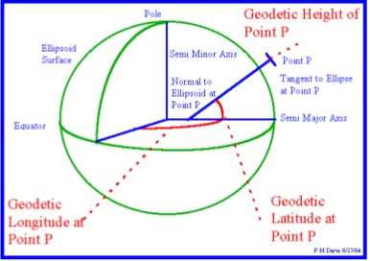
Coordinate Systems
A coordinate reference system (CRS), is a reference system for representing the location of a vector feature or a raster. There are two types of CRS:
Geographic coordinate systems
Takes earth as a spheroidal surface
Defined by datum, an estimate of earth’s surfaced based on an ellipsoid
Longitude (x) and latitude (y) as reference lines
Uses lat and long and angular measurement to define a position
Projected coordinate systems
Takes earth as a planar/flat surface
https://www.slideshare.net/yourmohsin/projections-and-coordinate-system

Slide 15
How can R Support GIS?
Large library of spatial analytical and statistical packages for both raster and vector data
Several packages to support both static and interactive maps
R package bindings of popular open source libraries, like Leaflet and GDAL
Reads and writes various spatial data formats: GeoJSON, shapefiles, GeoPackages, KML, spatial database conncetions (PostgreSQL, SpatialLite)
Allows non-spatial data to be assigned to spatial data
Notes:
ttps://www.gislounge.com/using-r-gis-software/

Slide 16
R Geospatial Architecture
Database
R Studio
Visualization
(e.g., rgdal, sf, sp, rjson)
(e.g., leaflet, tmap)
Geospatial features, layers
(API or static file)
Processing + Analysis / Statistic packages
Targeted audience
(e.g., rgdal, ggplot2, sf, sp)
Data collection (e.g., surveying, crowdsourcing, scraping)

Slide 17
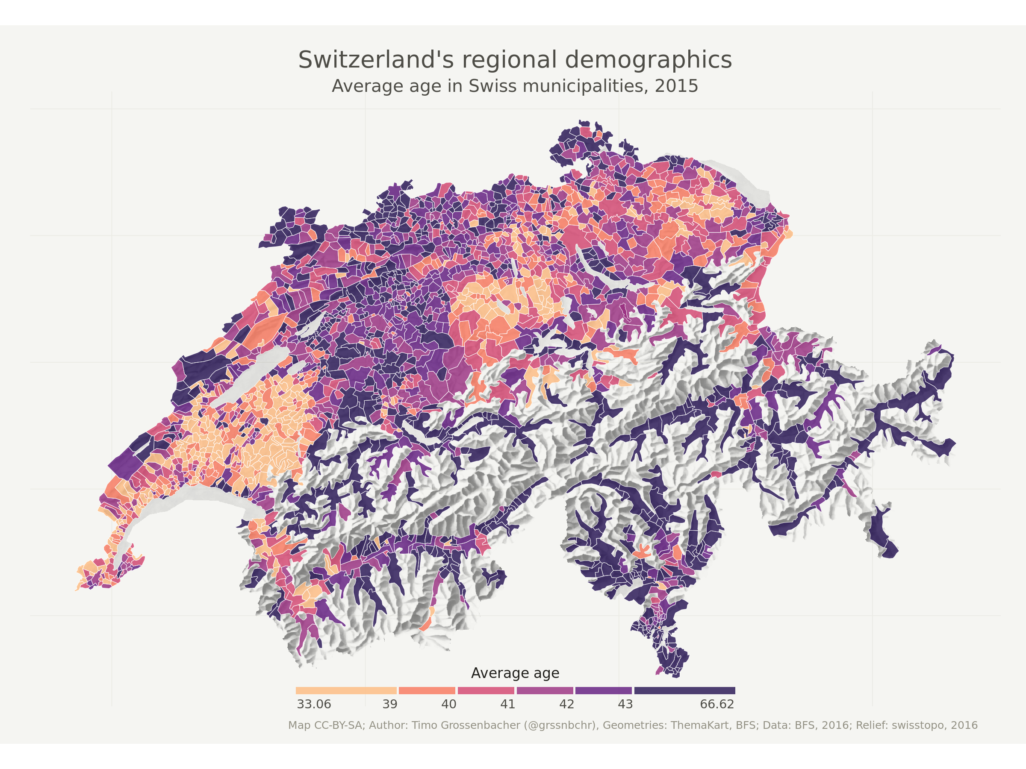
https://timogrossenbacher.ch/2016/12/beautiful-thematic-maps-with-ggplot2-only/

Slide 18
R Geospatial Packages
There’s lots: https://cran.r-project.org/web/views/Spatial.html
sp: classes and methods for spatial data; stores data as slots
sf: classes and methods for spatial data; stores data as simple features (well-known text geometry) within a dataframe
rgdal: geospatial data abstract library (GDAL) binding to read/write geospatial data (e.g., shapefiles, GeoPackages)
rgeos: geometry engine (open source) binding to manipulate and query geometric data
ggplot2: create static map plots
ggmap: extension of ggplot2 for additional map features
maptools: mapping functionality
tmap: thematic static or interactive maps
leaflet: JavaScript library binding for interactive mapping

Slide 19
Thematic Maps

Slide 20
Thematic Maps
Maps that show spatial distributions related to single or multiple themes
Linked to a geographic space (any scale) to interpret the place
Data can be qualitative or quantitative
Useful in exploratory spatial data analysis
Discover patterns and relationships between variables
Used to help form hypotheses
https://www150.statcan.gc.ca/n1/pub/92-195-x/2011001/other-autre/theme/def-eng.htm
Notes:
https://www150.statcan.gc.ca/n1/pub/92-195-x/2011001/other-autre/theme/def-eng.htm
“Thematic maps can be used for exploratory spatial data analysis, confirming hypotheses, synthesizing spatial data by revealing patterns and relationships, and data presentation.”

Slide 21
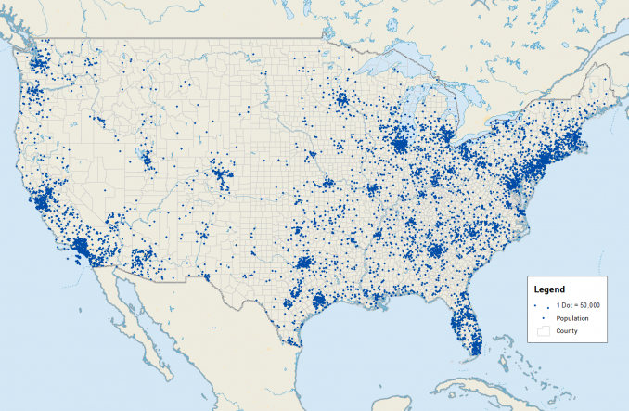
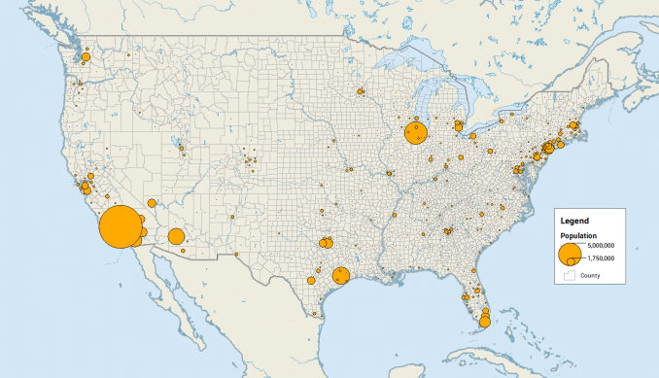
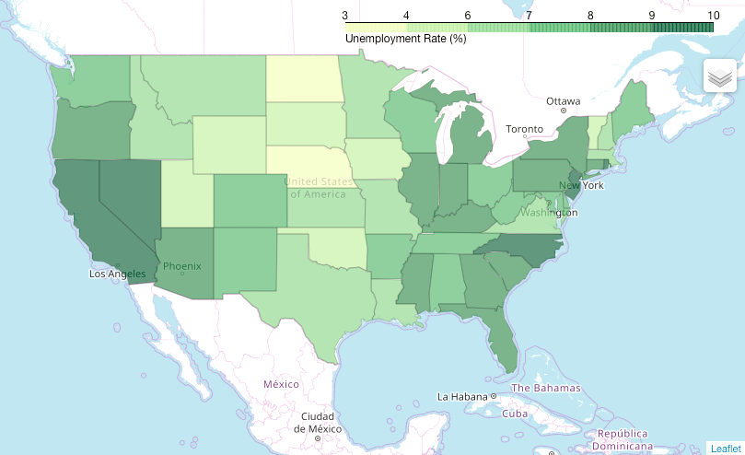
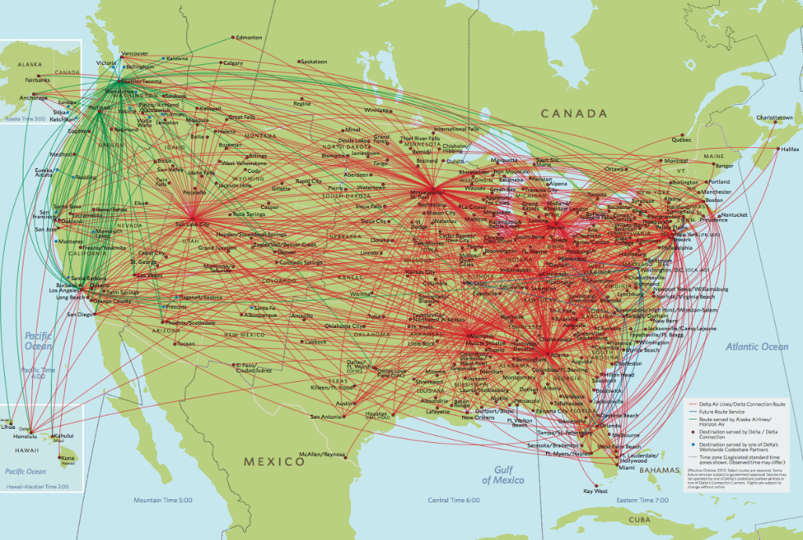
Some Thematic Map Types
Dot Density
Proportional Symbol
Choropleth
Flows
Notes:
https://www150.statcan.gc.ca/n1/pub/92-195-x/2011001/other-autre/theme/def-eng.htm
https://carto.com/blog/popular-thematic-map-types-techniques-spatial-data
https://gisgeography.com/dot-distribution-graduated-symbols-proportional-symbol-maps/
http://worldofmaps.blogspot.com/2013/06/flow-map-19.html
https://python-graph-gallery.com/292-choropleth-map-with-folium/

Slide 22
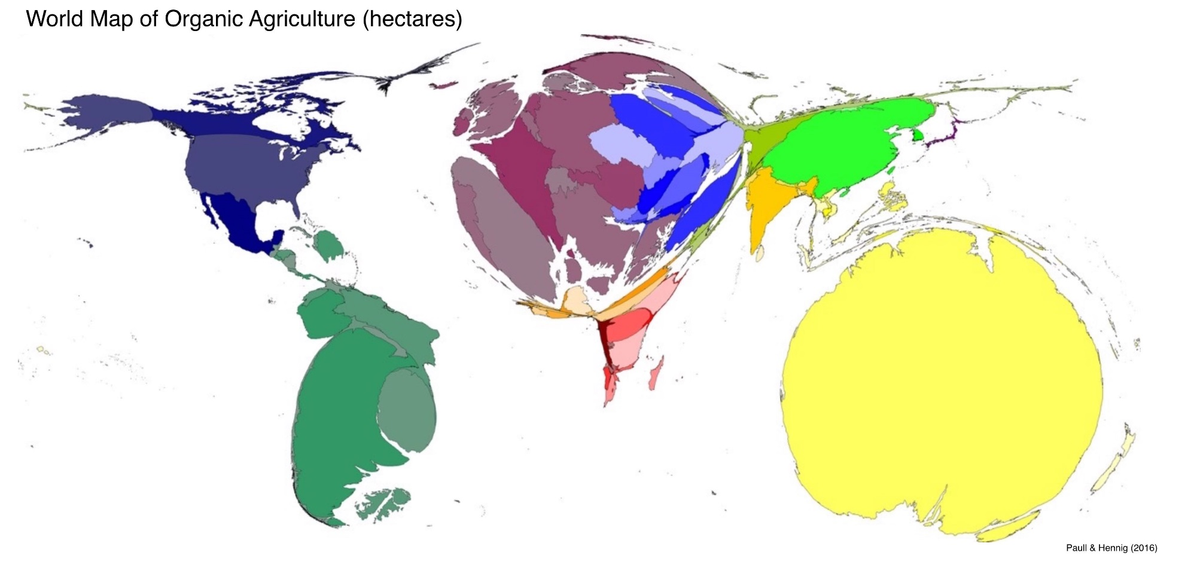
Cartograms
https://www.loxodrome.io/post/effective-cartograms/

Slide 23
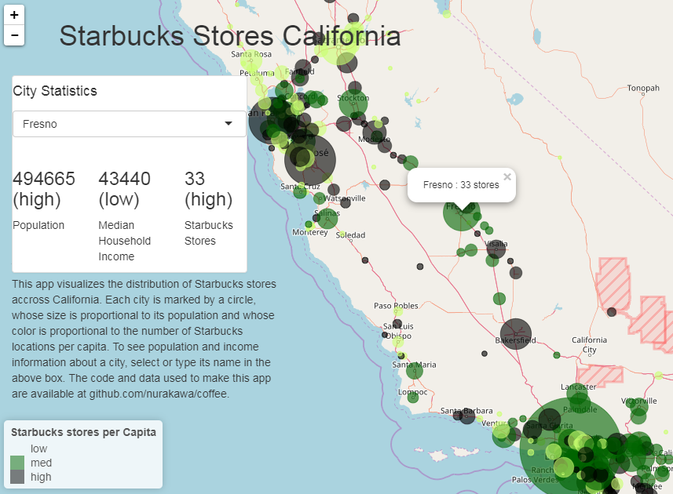

Slide 24
Choropleth Maps
Maps that show the spatial distribution of data linked to a specific areal unit (e.g., province/territory, census tract)
The data is either classified or unclassified and should be normalized to avoid population maps
Display data values through saturation/lightness (quantitative) or hues (qualitative)
Can organize, simplify, and generalize large information and complex spatial patterns into informative visualizations
Notes:
https://viscomvibz.wordpress.com/2012/03/17/the-pros-cons-of-choropleth-maps-blot-maps-patch-maps/

Slide 25
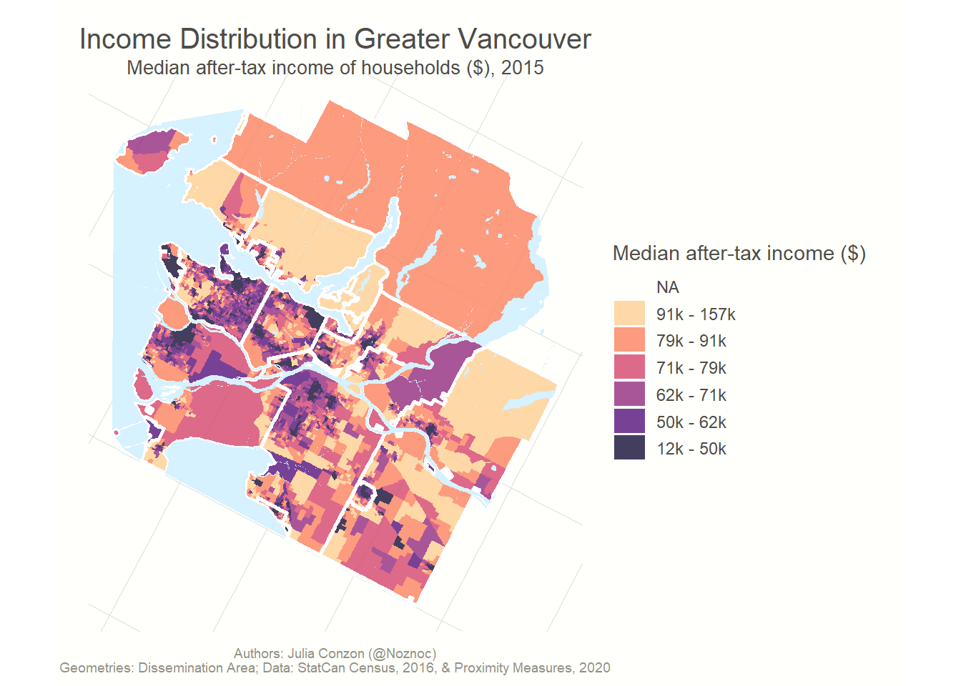
Bins

Slide 26
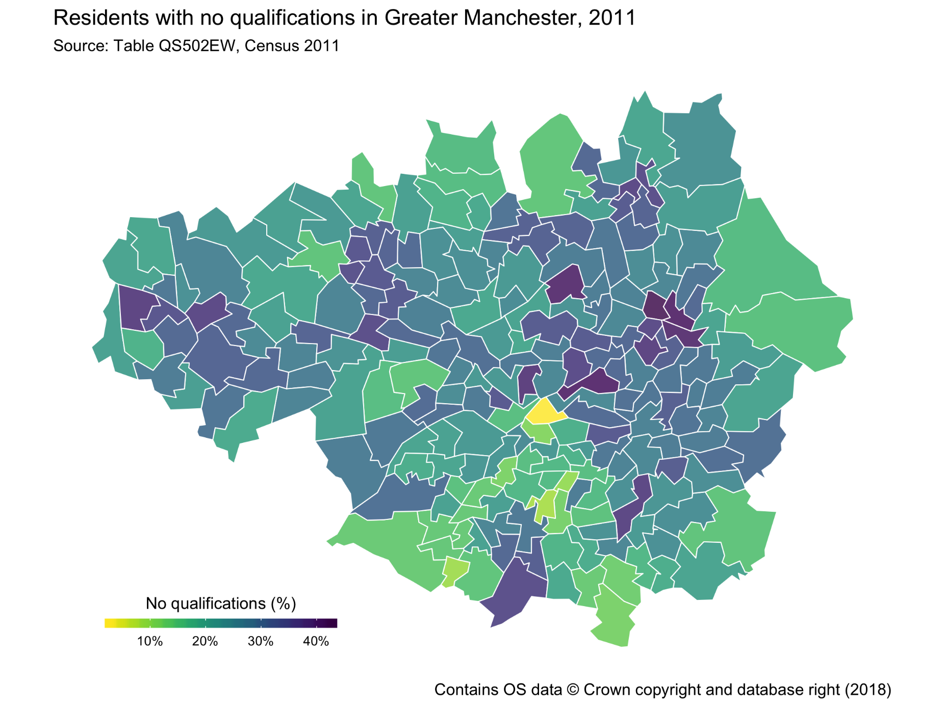
https://medium.com/@traffordDataLab/lets-make-a-map-in-r-7bd1d9366098

Slide 27
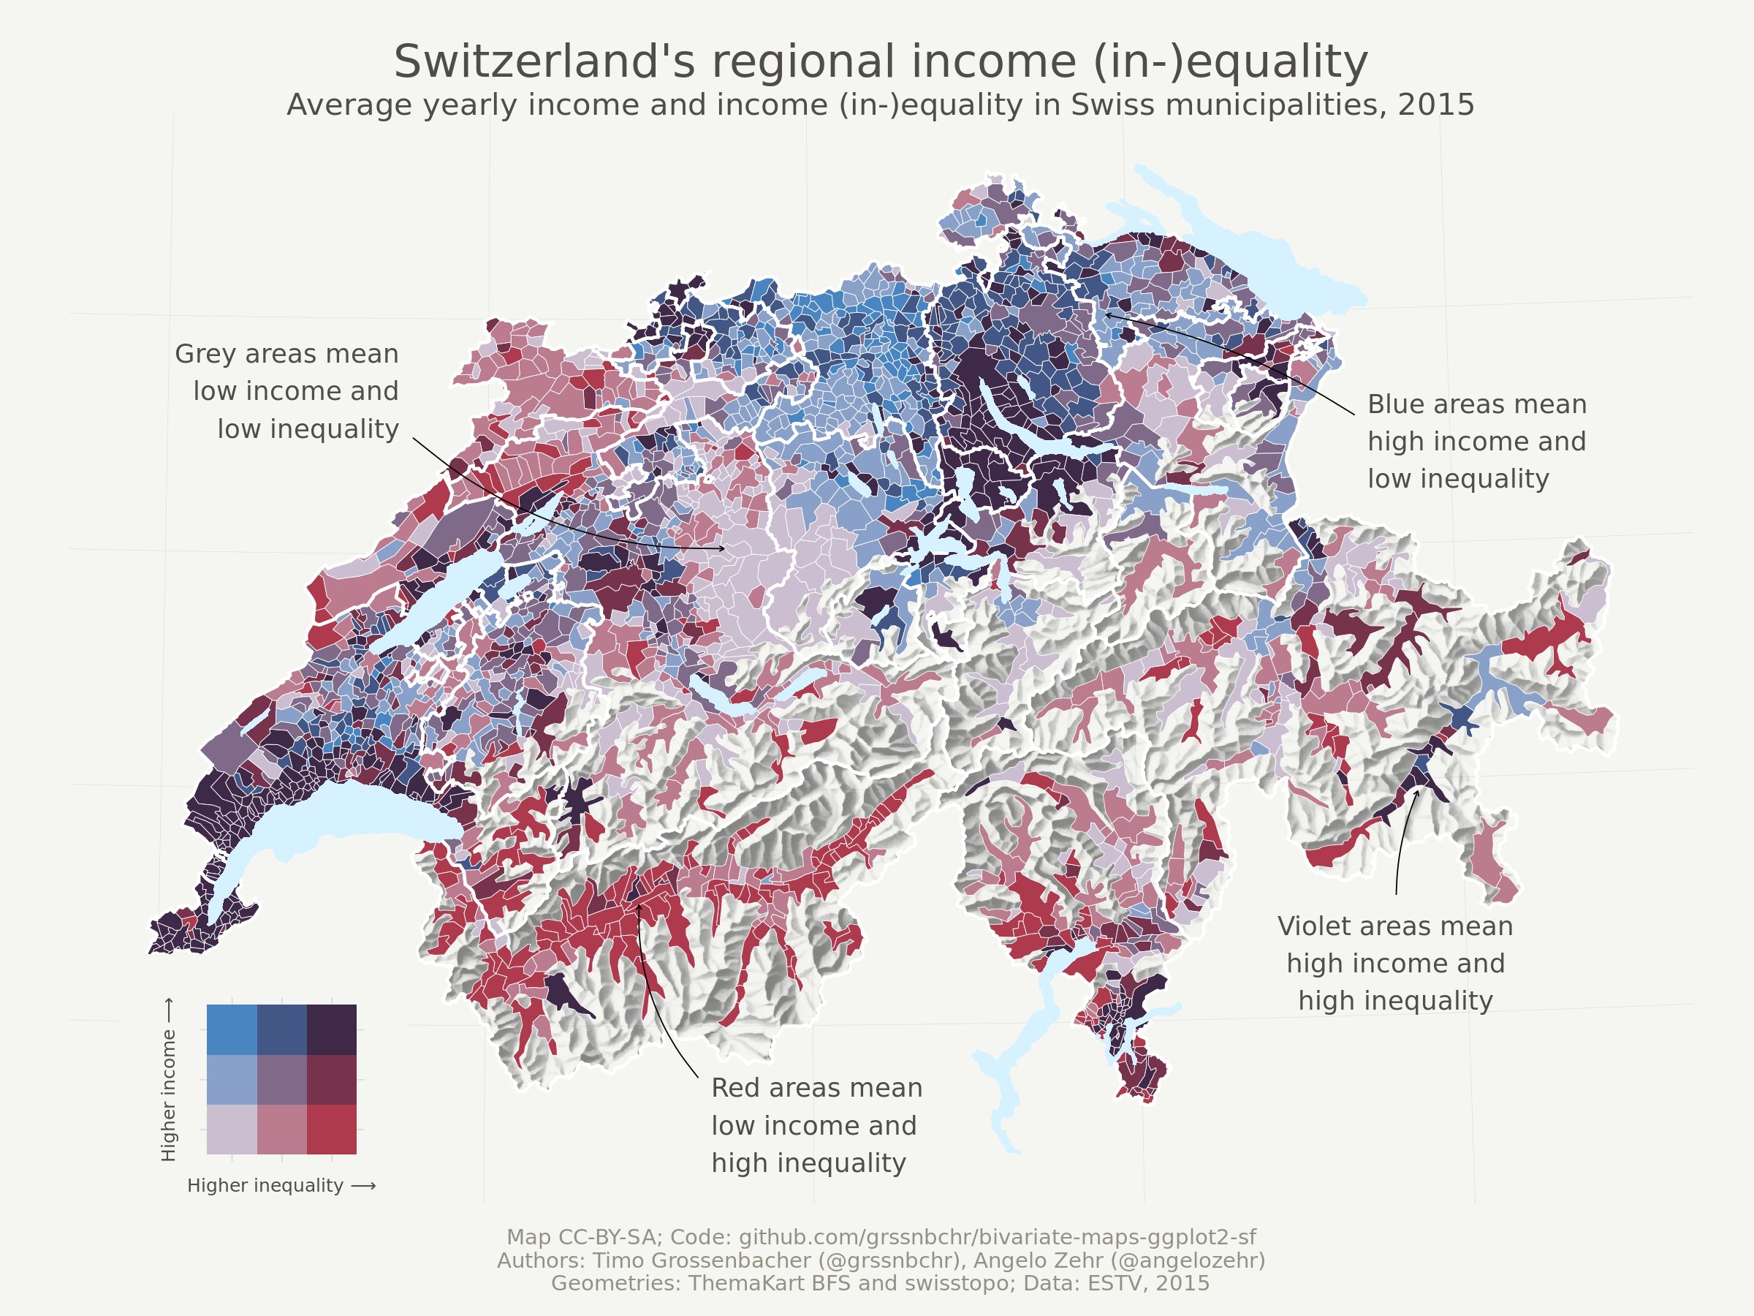
https://github.com/grssnbchr/bivariate-maps-ggplot2-sf
Notes:
Example of bivariate choropleth

Slide 28
Choropleth Development & Design
Select a study area (areal unit), data (e.g., indicators), and theme of interest
Classify the values
Assess distribution (histogram)
If data is quantitative:
Determine whether to use classes, and if so the number of classes
Choose the classification method
Select colour scheme
Plot map (static or interactive)

Slide 29
Areal Units
Data is usually aggregated to a Statistic Canada boundary files:
Provinces/territories; Federal electoral districts; Economic regions (ER); Census divisions (CDs); Aggregate dissemination areas (ADAs); Census subdivisions (CSDs); Census metropolitan areas and agglomerations (CMAs and CAs); Census tracts (CTs); Dissemination blocks and areas
Forward Sortation Areas (FSA) and Postal Codes, owned by Canada Post
Building footprints
https://www150.statcan.gc.ca/n1/pub/92-196-x/92-196-x2016001-eng.htm

Slide 30
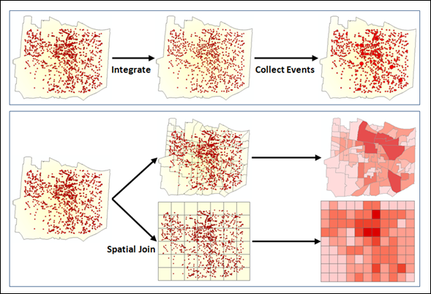
Aggregate Points to an Areal Unit

Slide 31
To Classify or Not
With quantitative data, you have the option of classifying or not classifying your data in a choropleth map. To classify or not, depends on your data range, theme/message, and audience
5-7 breaks are optimal (Brewer and Pickle 2002)
If your variable’s value range is large, then consider unclassified (graduated color scheme)
How are the data distributed throughout the range? And what, if any, class breaks might have a particular meaning to the map user? – Mark Monmonier (p. 163)
Notes:
https://www.arcgis.com/apps/MapJournal/index.html?appid=75eff041036d40cf8e70df99641004ca
http://www.gitta.info/Statistics/en/html/StandClass_learningObject2.html

Slide 32
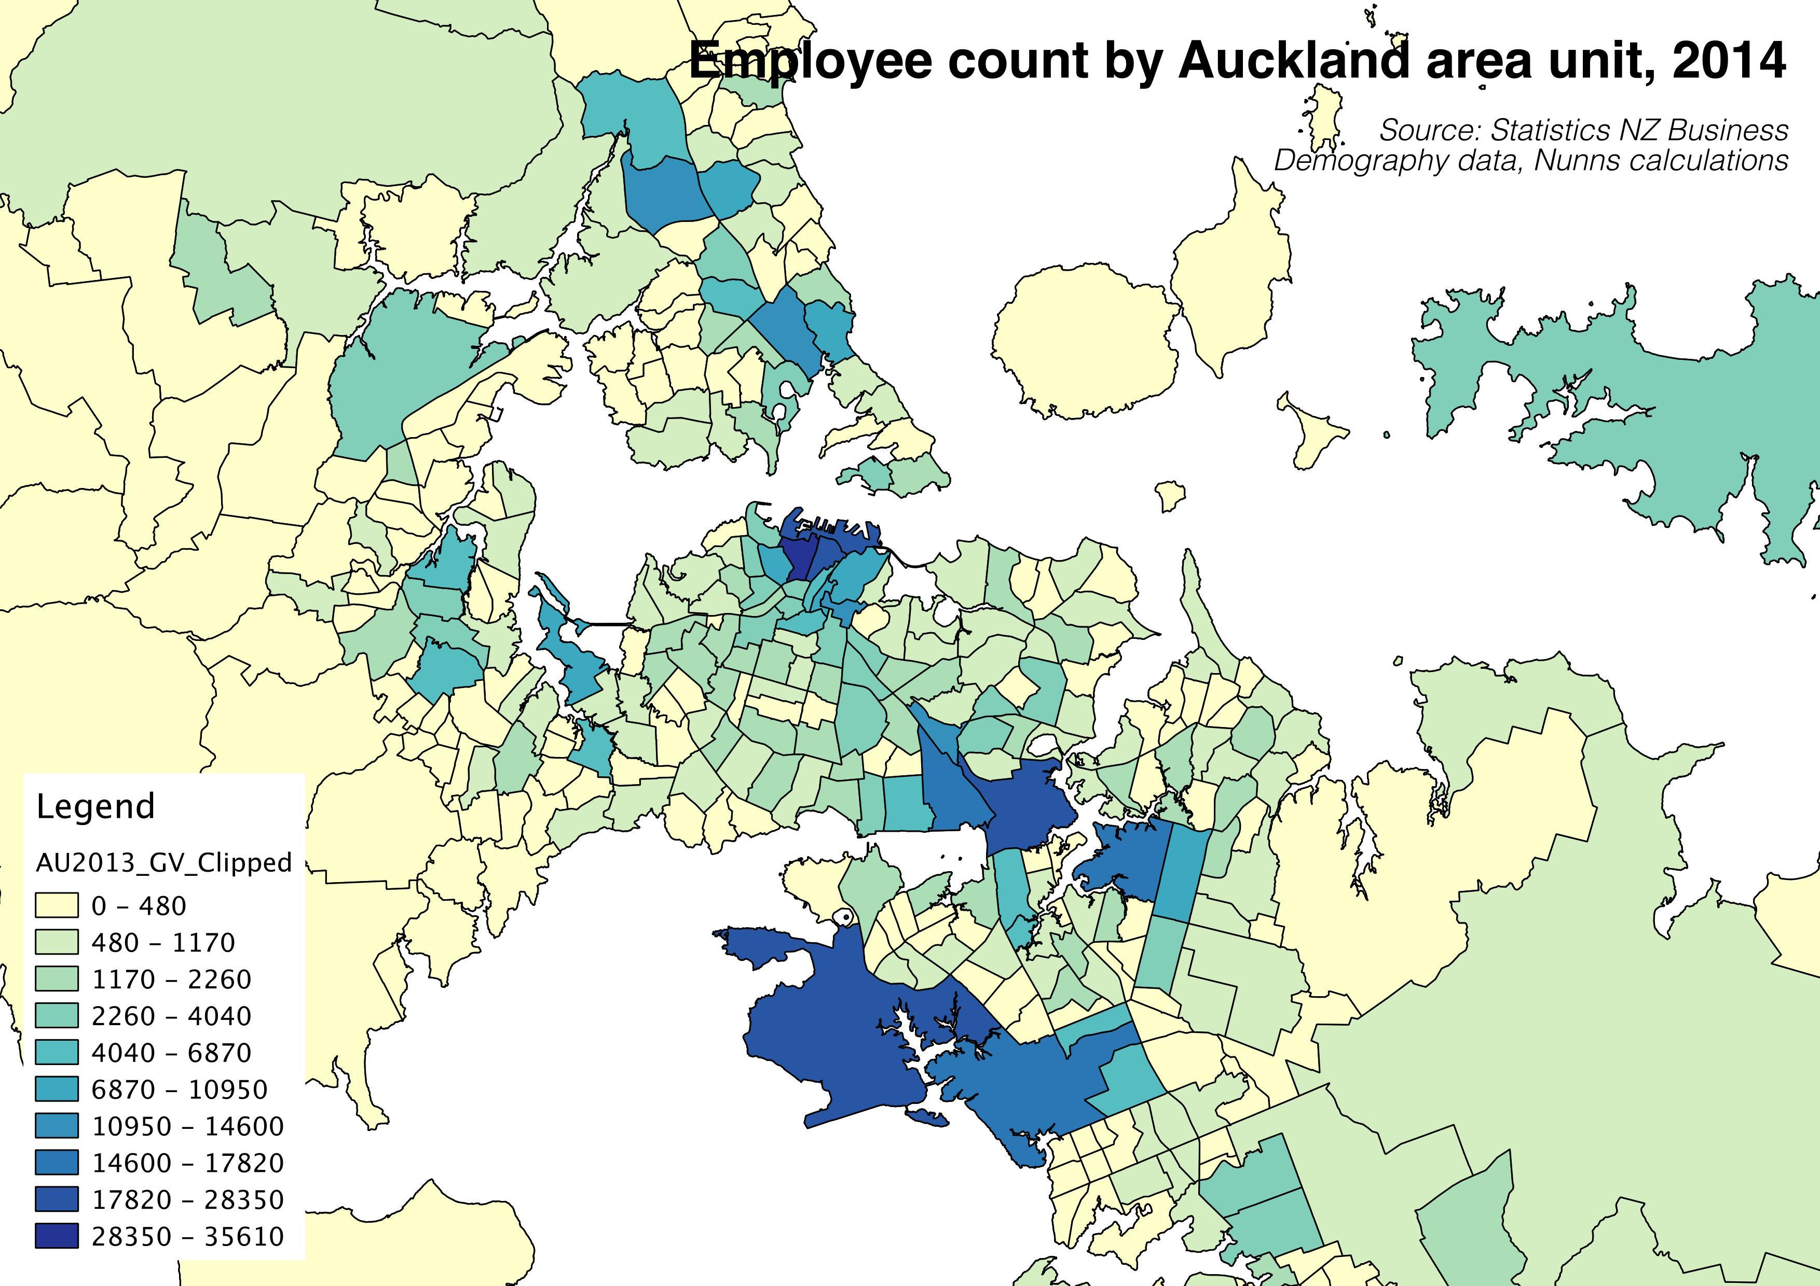
Too many classes
Class breaks are misleading
https://www.greaterauckland.org.nz/2015/01/13/the-geometry-of-urban-labour-markets/

Slide 33
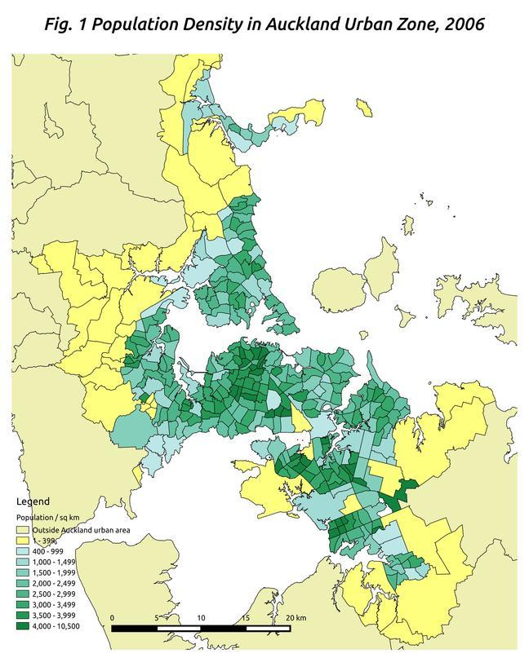
Too many classes
Classification method?
http://popbytes.co.nz/?p=9

Slide 34
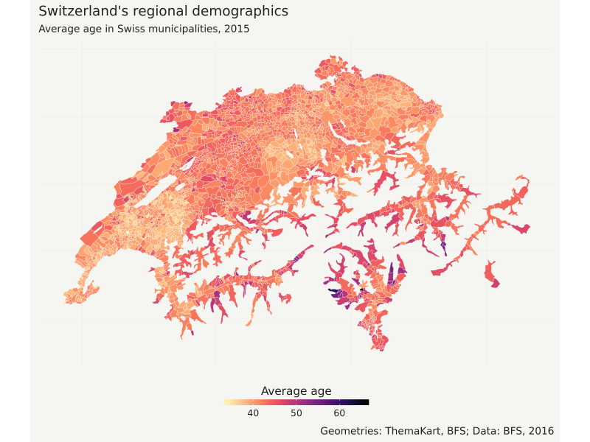
Gradient color scheme with breaks
https://blog.revolutionanalytics.com/2016/12/swiss-map.html

Slide 35
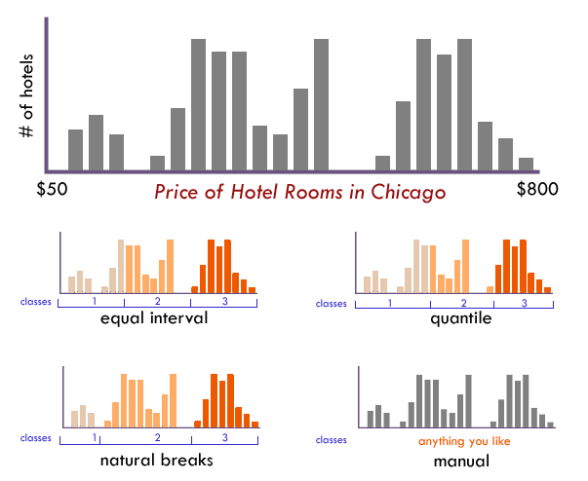
Classification
Classes/Bins group data values while stops/breaks are the values that separate the classes
Classification methods organize similar values into classes
Quantile
Standard deviation
Equal interval
Jenks (Natural Breaks)
Manual
Pretty breaks
https://www.axismaps.com/guide/data/data-classification/

Slide 36
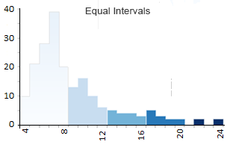
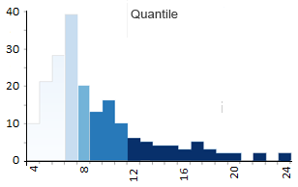
Classification Methods
Equal interval based on range: groups data values into equal intervals
(maxValue – minValue) / class #
This can cause unequal amounts of values across the classes
Quantile: groups data into classes of same quantity (4 = quartile, 5 = quintile)
(total # of features / class #) to get the average, then the method tries to count the quantity in each group closest to the average
Can be easier to interpret, but the method can cause very different values being classified into same groups
(De Smith et al. 2018)
Notes:
https://gisgeography.com/choropleth-maps-data-classification/

Slide 37
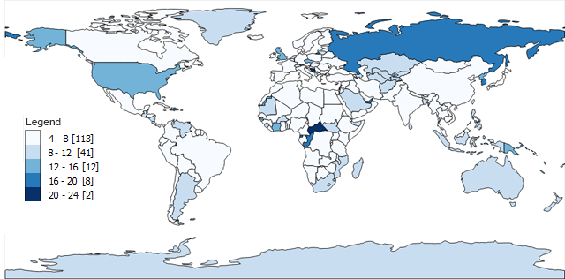
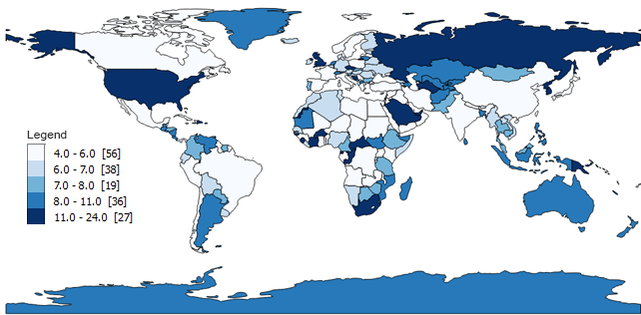
Equal Interval
(values represent number of letters in a country’s names)
Quantile
https://gisgeography.com/choropleth-maps-data-classification/

Slide 38
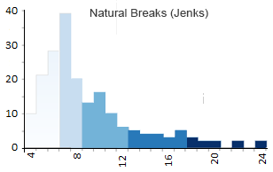
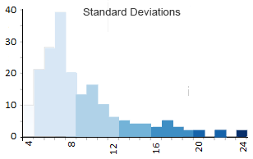
Classification Methods (continued)
Jenks (Natural Breaks): groups data by reducing the amount of variance within classes and maximize variance between classes
Method randomly selects breaks, then through an iterative process, minimizes each class’s average deviation from the class mean
Can highlight outliers in own classes
Cannot be used to compare maps because of how the method’s initial randomization step
Standard Deviation: groups data by adding/subtracting the standard deviation from the mean
Best for data that is normally distributed
(De Smith et al. 2018; Jenks 1971)
Notes:
https://gisgeography.com/choropleth-maps-data-classification/
https://en.wikipedia.org/wiki/Jenks_natural_breaks_optimization

Slide 39
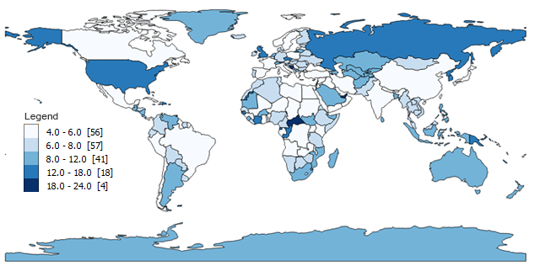
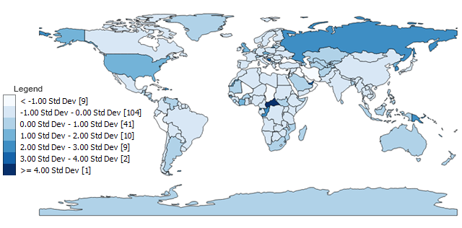
Jenks
Standard Deviation
https://gisgeography.com/choropleth-maps-data-classification/

Slide 40
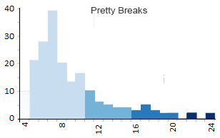
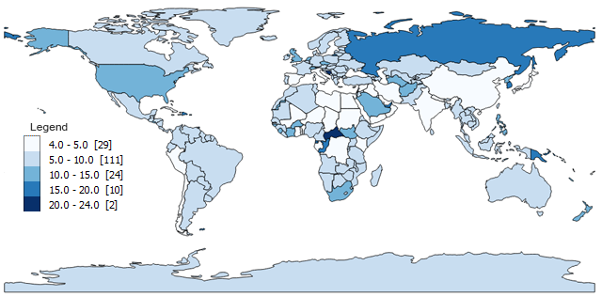
Classification Methods (continued)
Pretty breaks: groups data values into classes that allow the breaks to be rounded values
Instead of a break being 499.231, it would be 500
Manual: manually select the breaks
(De Smith et al. 2018)
Notes:
https://gisgeography.com/choropleth-maps-data-classification/

Slide 41
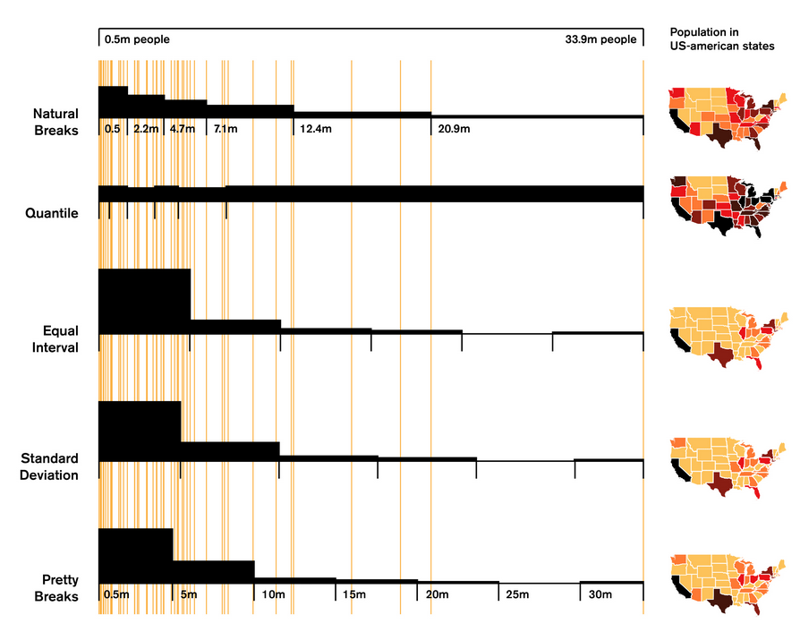
Notes:
https://rpubs.com/danielkirsch/styling-choropleth-maps

Slide 42
Classification Methods in R
With tmap R package to create the choropleth maps. This package depends on the classIntervals package for the classification methods:
https://www.rdocumentation.org/packages/classInt/versions/0.3-3/topics/classIntervals
Manual = “fixed”
Quantile = “quantile”
Pretty breaks = “pretty”
Not discussed, but are offered in package:
“k means”
“fisher”
Jenks = “jenks”
Standard deviation = “sd”
Equal intervals based on range = “equal”
Hierarchical clustering = “hclust”
Bagged clustering = “bclust”

Slide 43
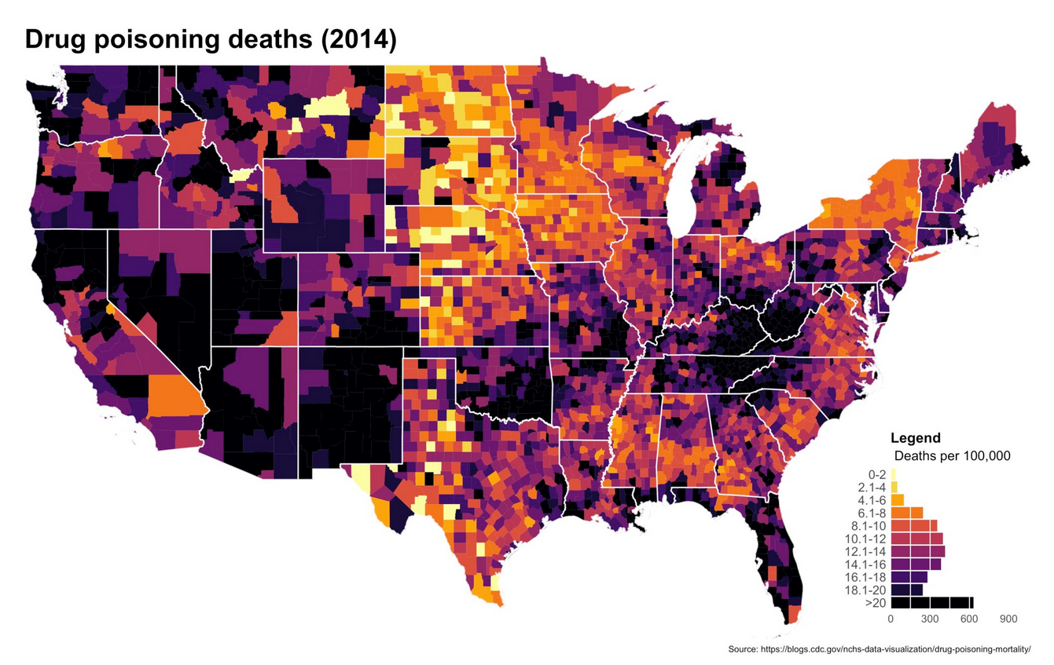
Histogram legend
https://mathewkiang.com/2017/01/16/using-histogram-legend-choropleths/

Slide 44
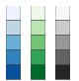
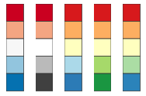
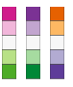
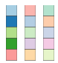
Colours
Quantitative
Sequential
Is your data qualitative or quantitative? Sequential or diverging?
Multi-hue colour schemes are best for qualitative data
Gradient-hues as well as varying saturation colour schemes are best for quantitative data
What message are you trying to convey?
Diverging
Qualitative
Using blue/green to represent “good” and red to represent “bad”, but consider your audience
http://colorbrewer2.org/

Slide 45
Choropleth Reflections + Limitations
Default classification on software
Modifiable Areal Unit Problem (MAUP): boundaries can influence the presentation of the data, different boundary aggregates will yield different results
Comparing choropleth maps / correlation choropleth maps
Always question the map!
Data sources
Classification
What is the map trying to show or hide?
Notes:
Source:
https://www.gislounge.com/modifiable-areal-unit-problem-gis/
https://www.r-graph-gallery.com/chloropleth-map/
https://www.citylab.com/design/2015/06/when-maps-lie/396761/

Slide 46
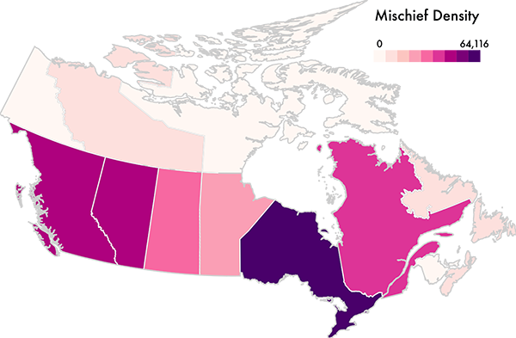
Question the map!

Slide 47
How is mischief defined?
Title?
Projection?
What do the values represent? Count? Is that appropriate?
Should areal unit be more granular?

Slide 48
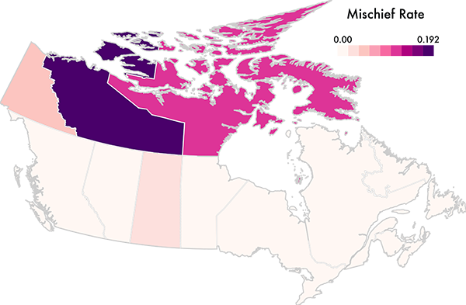
Now proportional to population
https://medium.com/@uwdata/surprise-maps-showing-the-unexpected-e92b67398865

Slide 49
R + Choropleth Resources
https://www.r-graph-gallery.com/chloropleth-map/R choropleths
https://r4ds.had.co.nz/workflow-basics.html
https://geocompr.robinlovelace.net/adv-map.html
https://www12.statcan.gc.ca/census-recensement/2011/geo/map-carte/ref/thematicmaps-cartesthematiques-index-eng.cfm
https://timogrossenbacher.ch/2019/04/bivariate-maps-with-ggplot2-and-sf/

Slide 50
Citations
Brewer, Cynthia A. and Linda Pickle. 2002. “Evaluation of Methods for Classifying Epidemiological Data on Choropleth Maps in Series.” Annals of the Association of American Geographers, 92(4), 662-681. http://www.personal.psu.edu/cab38/Brewer_Annals.pdf
De Smith, Michael J., Michael F Goodchild, Paul A Longley. Geospatial Analysis: A Comprehensive Guide to Principles Techniques and Software Tools. 2018. www.spatialanalysisonline.com/HTML
Jenks, G. F., Caspall, F. C., 1971. "Error on choroplethic maps: definition, measurement, reduction". Annals, Association of American Geographers, 61 (2), 217-244
Monmonier, Mark. How to Lie with Maps. University of Chicago Press. 2018.

Slide 51
Appendix

Slide 52
What is R?
Open source interpreted language and environment for data handling, storage, analysis and graphics
Users leverage existing packages within the Comprehensive R Archive Network (CRAN) and can contribute to, or develop their own, packages
The R environment supports the entire data science/analysis workflow, from data collection to visualization/communication
https://cran.r-project.org/
Notes:
https://www.r-project.org/about.html
https://bookdown.org/robinlovelace/geocompr/

Slide 53
What is RStudio?
Most popular Integrated Development Environment (IDE) for R
Available in two editions: RStudio Desktop and R Studio Server
Runs on Windows, Mac and Linux
Newest version (v1.2.1335) have support for Python and D3
https://www.rstudio.com/
Notes:
https://www.rstudio.com/products/RStudio/

Slide 54
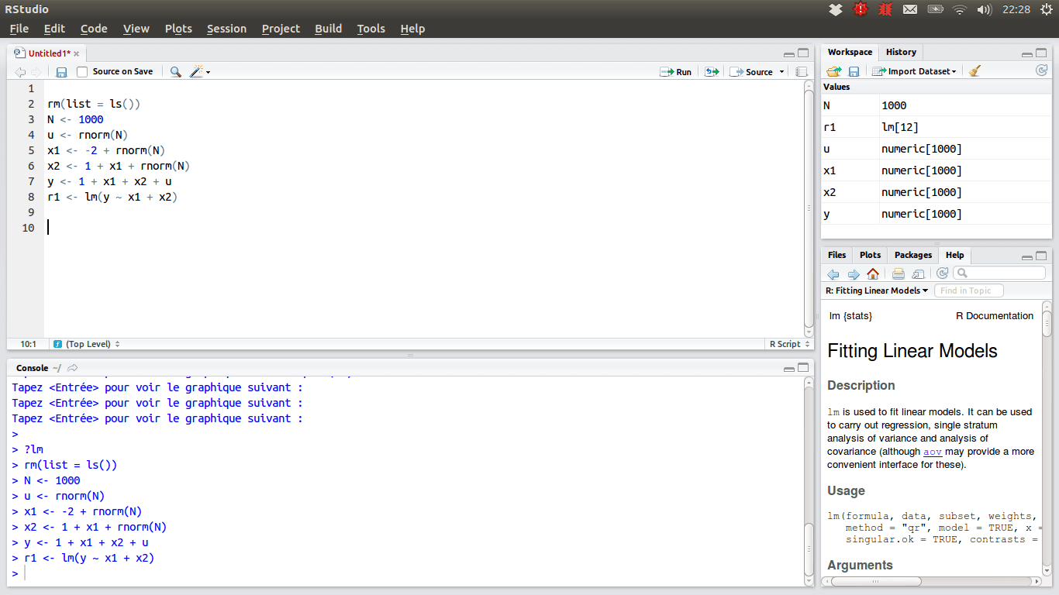
RStudio User Interface
Top Left - A script window (tabbed so you can load several)
Notes:
Top Left - A script window (built-in text editor)
Bottom Left - location were commands are entered and the output is printed
Top Right - interactive list of loaded R objects & list of key strokes entered into the console
Bottom Right – files, graphs, packages, help
tables here)
Source:
http://ncss-tech.github.io/stats_for_soil_survey/chapters/1_introduction/1_introduction.html

Slide 55
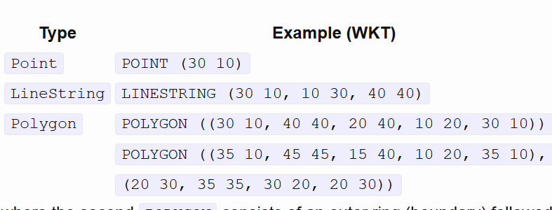
Well-Known Text (open)
Text markup language that stores vector geometry
Well-Known Binary (WKB) is used to transform this information in databases
R simple features (sf)
https://www.r-spatial.org/r/2016/02/15/simple-features-for-r.html

Slide 56


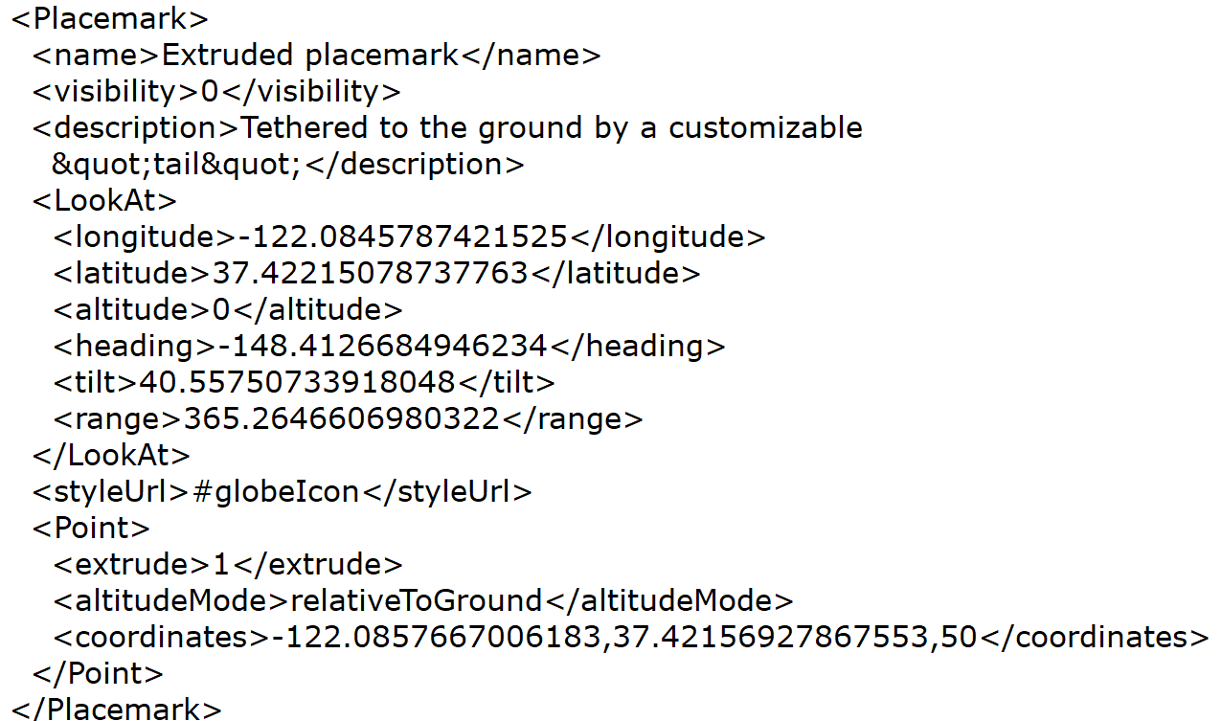
KML (Google)
https://developers.google.com/kml/documentation/kml_tut

Slide 57
GeoPackages (open)
Fairly new format for geospatial data (2014)
Stores geospatial information in a SQLite database:
Vector features
Imagery/Raster tilesets
Attribute information
The GeoPackage Encoding Standard defines the schema
https://www.geopackage.org/

